Slide 1


Student Performance Analysis: Predicting Academic Success
A Data Science Approach to Identifying Key Performance Factors

Slide 2

Introduction & Problem Statement
Project Goal:
Build a predictive model to identify at-risk students and determine the most influential factors affecting success.
Why This Project Matters:
Early identification of at-risk students
Understanding key performance factors
Data-driven insights over subjective assessments

Slide 3
Dataset Overview
Key Information:
Feature Categories:
5,000 student records
Demographic: Age, Gender, Ethnicity
15 original + 6 new features
Academic: GPA, Study Time Weekly
Target: Class_Grade (0-3 scale)
Attendance: Absence_Rate, Absence Impact
Support: Parental Education, Parental_Support, Tutoring
Extracurricular: Sports, Music, Volunteering

Slide 4
Data Cleaning Process
01
02
Drop StudentID
Verify No Missing Values
Removed irrelevant unique identifier.
Ensured 0% missing data.
03
04
Rename Columns
Check Duplicates & Outliers
Improved clarity for analysis.
Confirmed no duplicates or significant outliers.
Cleaning ensures reliable analysis and modeling from real-world data inconsistencies.

Slide 5
Feature Engineering
Creating new features captures meaningful relationships and provides more predictive signals than raw data.
Is_Child
Study_Efficiency
Absence_Rate_Category
Age < 18 (captures developmental differences)
StudyTime/Absences
(better than raw study hours)
Categorized as Low/Medium/High
Total_Activities
Absence_Impact & Study_Impact
Sum of extracurriculars
Direct measures of effect on GPA

Slide 6
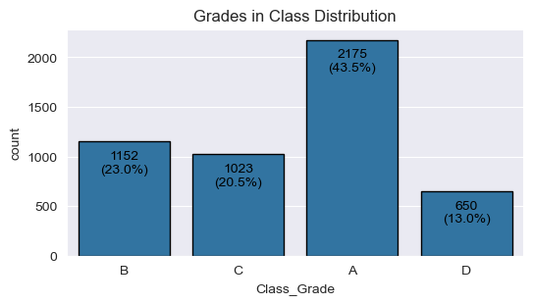
Target Variable Distribution
The relatively balanced distribution ensures accuracy as a reliable metric and prevents model bias.

Slide 7
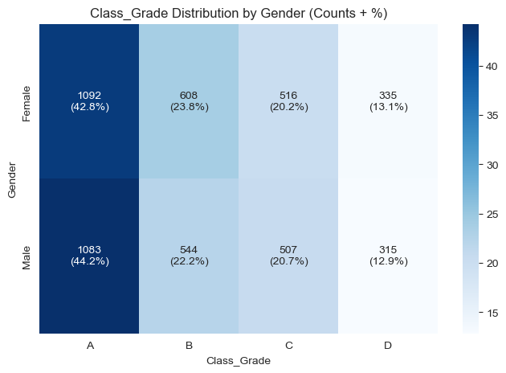
Gender vs. Academic Performance
Female students consistently outperform male students across all grade categories, with the gap most pronounced in higher performance.
42.8% of female students achieved A grades.
44.2% of male students achieved A grades.
Recommendation: Investigate gender-specific learning approaches and consider tailored support for male students.

Slide 8
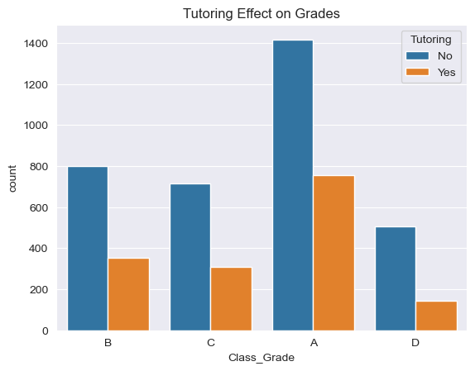
Tutoring Popularity
Tutoring has a clear positive effect on student performance
Students with tutoring achieve a higher proportion of A Grades
Tutoring significantly reduces the number of D Grades
Recommendation: Encourage a wider access to tutoring programs to boost overall academic success and reduce failure rates.

Slide 9
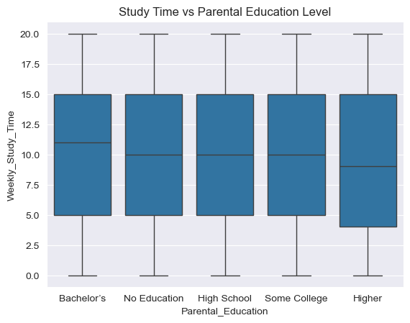
Parental Education Impact
Parental education level shows little influence on students’ weekly study time.
Median study time remains similar across all parental education levels.
Wide variation exists in every group, suggesting individual factors matter more.
Recommendation: Focus on motivating students directly rather than relying on parental background to influence study habits.

Slide 10


Unlocking Student Success: A Data-Driven Approach

Slide 11

Chapter 1
Key Insights from Student Data

Slide 12
Parental Education Impact
Higher parental education levels strongly correlate with better student performance.
Bachelor's+
35.7
High School or less
18.2
This clear progression highlights the need for additional support mechanisms for students from backgrounds with lower parental education.

Slide 13
Study Efficiency Analysis
Study efficiency (StudyTime/Absences) is a more critical factor than raw study hours for student success.
High Efficiency, Moderate Study
Optimal Balance
Diminishing Returns
10-15 hours/week with fewer than 10 absences.
Outperformed those with high study time but poor attendance.
Beyond 15 hours/week when attendance is good.
Focus interventions on improving attendance AND study habits, not just increasing study hours.

Slide 14

Chapter 2
Model Selection & Performance

Slide 15
Model Selection & Evaluation
We tested multiple machine learning models to ensure the most appropriate solution for predicting student performance.
Models Tested
Evaluation Metrics
Logistic Regression
Support Vector Classifier (SVC)
Accuracy
K-Nearest Neighbors (KNN)
Log Loss
Random Forest
Precision/Recall/F1
XGBoost
Confusion Matrix analysis

Slide 16
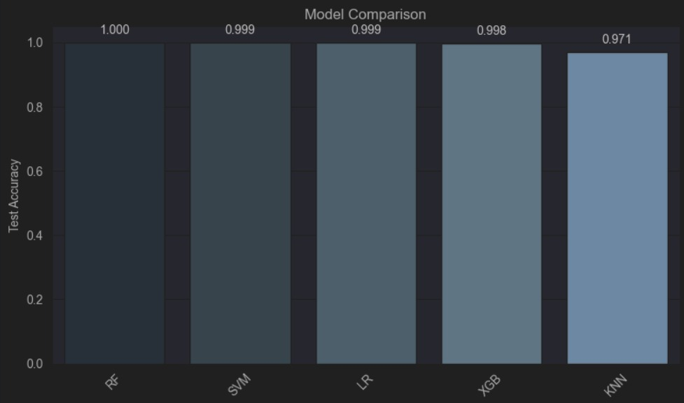
Model Performance Comparison
XGBoost emerged as the top performer due to its ability to handle non-linear relationships, built-in regularization, and high accuracy with good generalization.

Slide 17
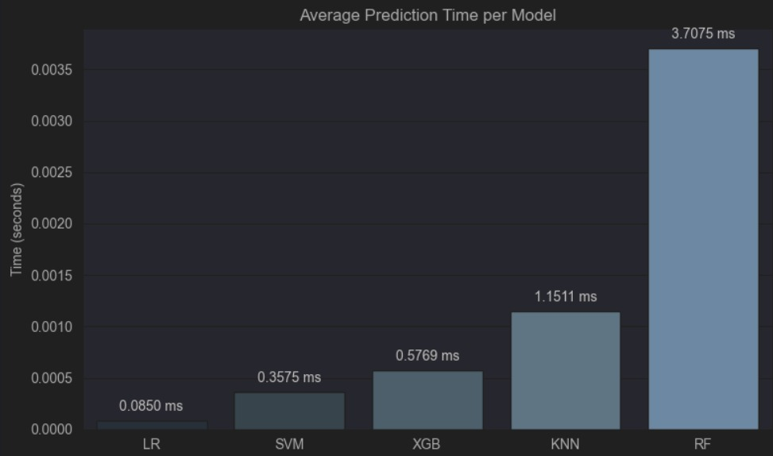
Model Performance Comparison
XGBoost emerged as the top performer due to its ability to handle non-linear relationships, built-in regularization, and high accuracy with good generalization.

Slide 18
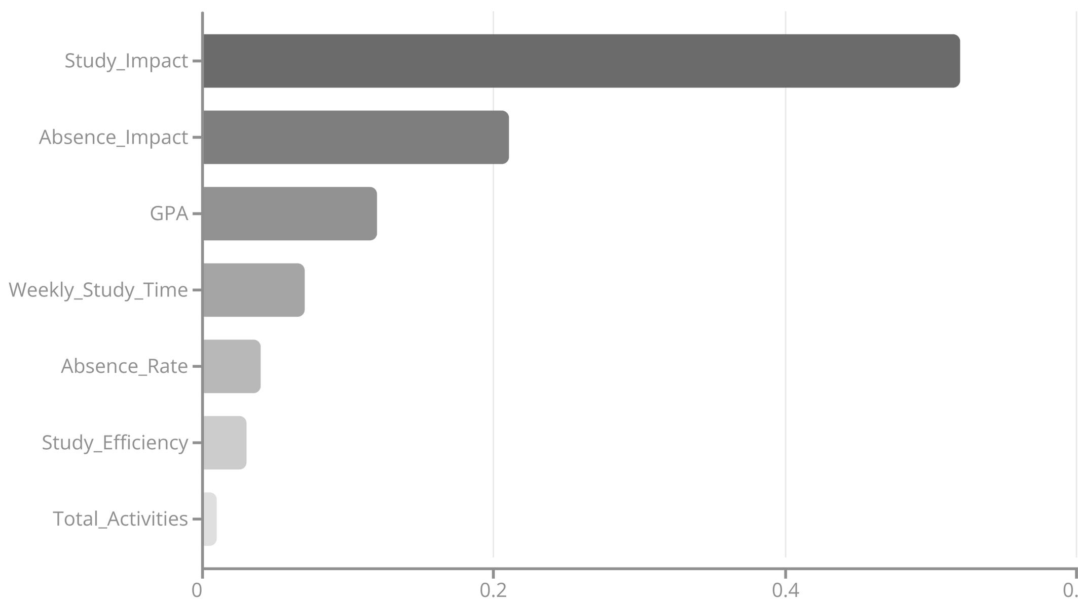
Feature Importance (Random Forest)
Our engineered impact features are significantly more predictive than raw features.

Slide 19





Key Insights Summary
Study Efficiency
Attendance Impact
Parental Education
Crucial for success, not just hours spent.
Stronger negative impact than study time's positive.
Low impact on student outcomes.
Targeted Tutoring
Extracurriculars
Moderate involvement (1-2 activities) correlates with best outcomes.
Most effective for struggling students.
These insights shift focus from traditional metrics to a more nuanced understanding of student performance drivers.

Slide 20
Actionable Recommendations
For School Administrators
01
02
03
Implement Early Warning System
Target Tutoring
Parental Engagement Programs
For students with >10 absences or <5 hours weekly study.
Develop for families with lower education levels.
Track Absence_Rate and Study_Efficiency.
04
05
Study Efficiency Workshops
Promote Balanced Extracurriculars
Focus on efficiency, not just more study hours.
Encourage 1-2 meaningful activities.
Implementation Strategy: Start with pilot programs for at-risk students identified by our model before scaling.

Slide 21

Future Work Improvements
Collect more granular study method data
Add qualitative feedback mechanisms
Track student performance over time
Incorporate teacher assessments

Slide 22
Conclusion
Key Takeaways
Student performance is multi-factorial - no single factor explains everything
Our KNN model (97.1% accuracy) can reliably identify at-risk students
Study efficiency and consistent attendance matter more than absolute study hours
Targeted interventions based on data can significantly improve outcomes

Slide 23

Thank You
For more information or to discuss implementation, please contact us.

